Slide 1

School of Computing Science & Engineering
Course Code: BCS01T1001 Course Name: Data Analytics
Installing Data Analysis Tool in Excel
Faculty Name: Dr. Varun Tiwari Program Name: B.Tech

Slide 2
Installing Data Analysis Tool in Excel
Click on the File tab, click Options, and then click the Add-Ins category.
In the Manage box, select Excel Add-ins and then click Go.
In the Add-Ins available box, select the Analysis Tool Pack check box, and then click OK.

Slide 3
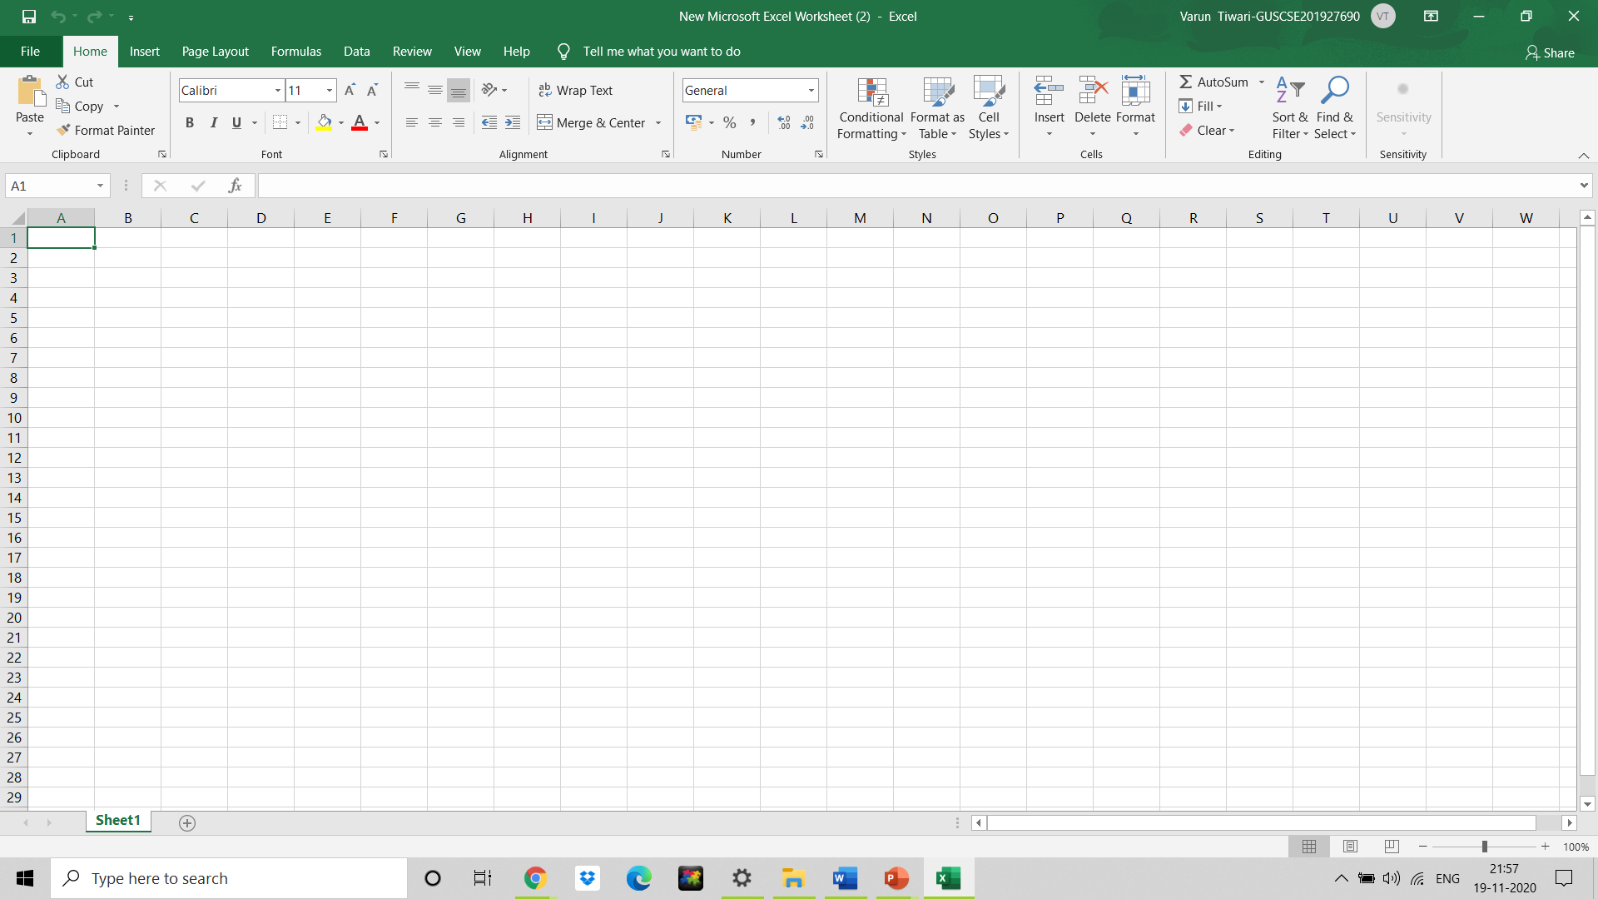
Installing Data Analysis Tool in Excel
Click on the File tab

Slide 4
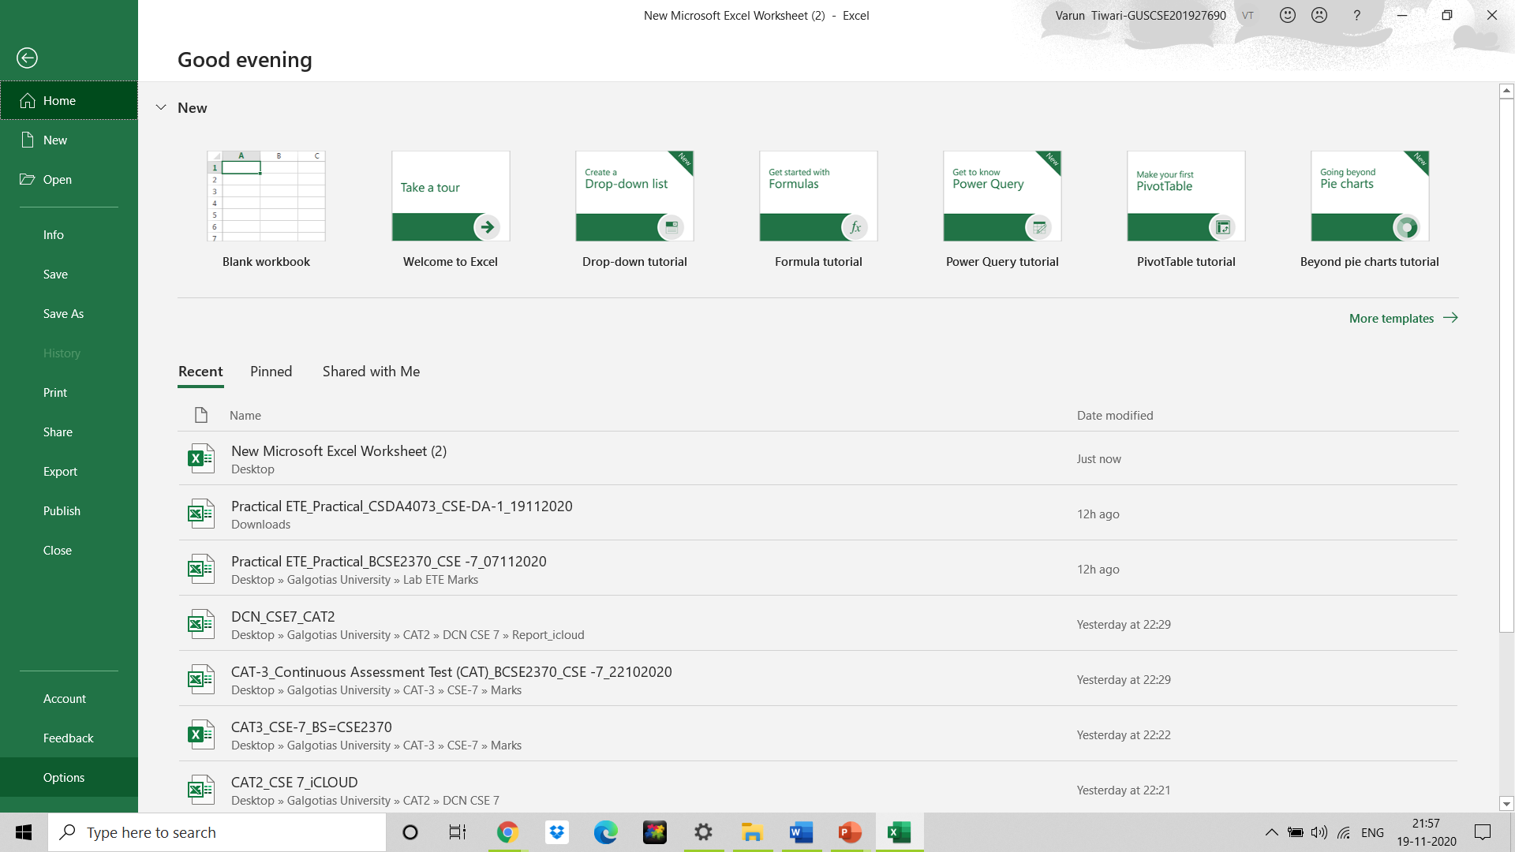
Installing Data Analysis Tool in Excel
Click on Options

Slide 5
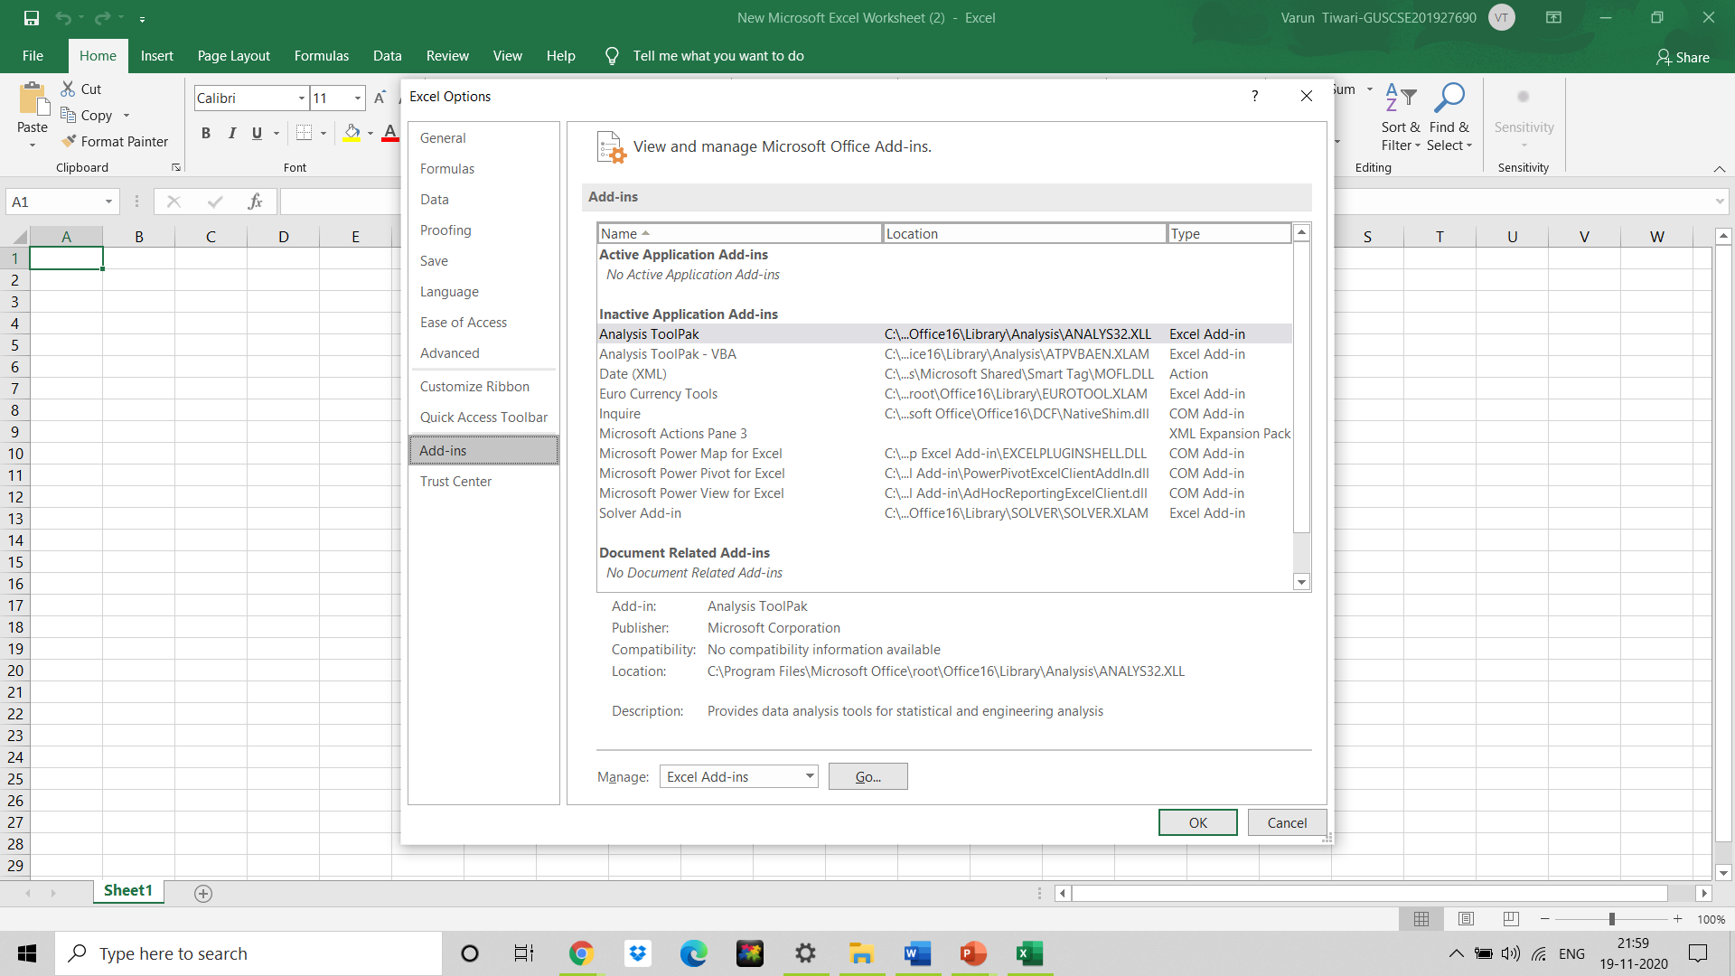
Installing Data Analysis Tool in Excel
Click on the Add-Ins Category

Slide 6
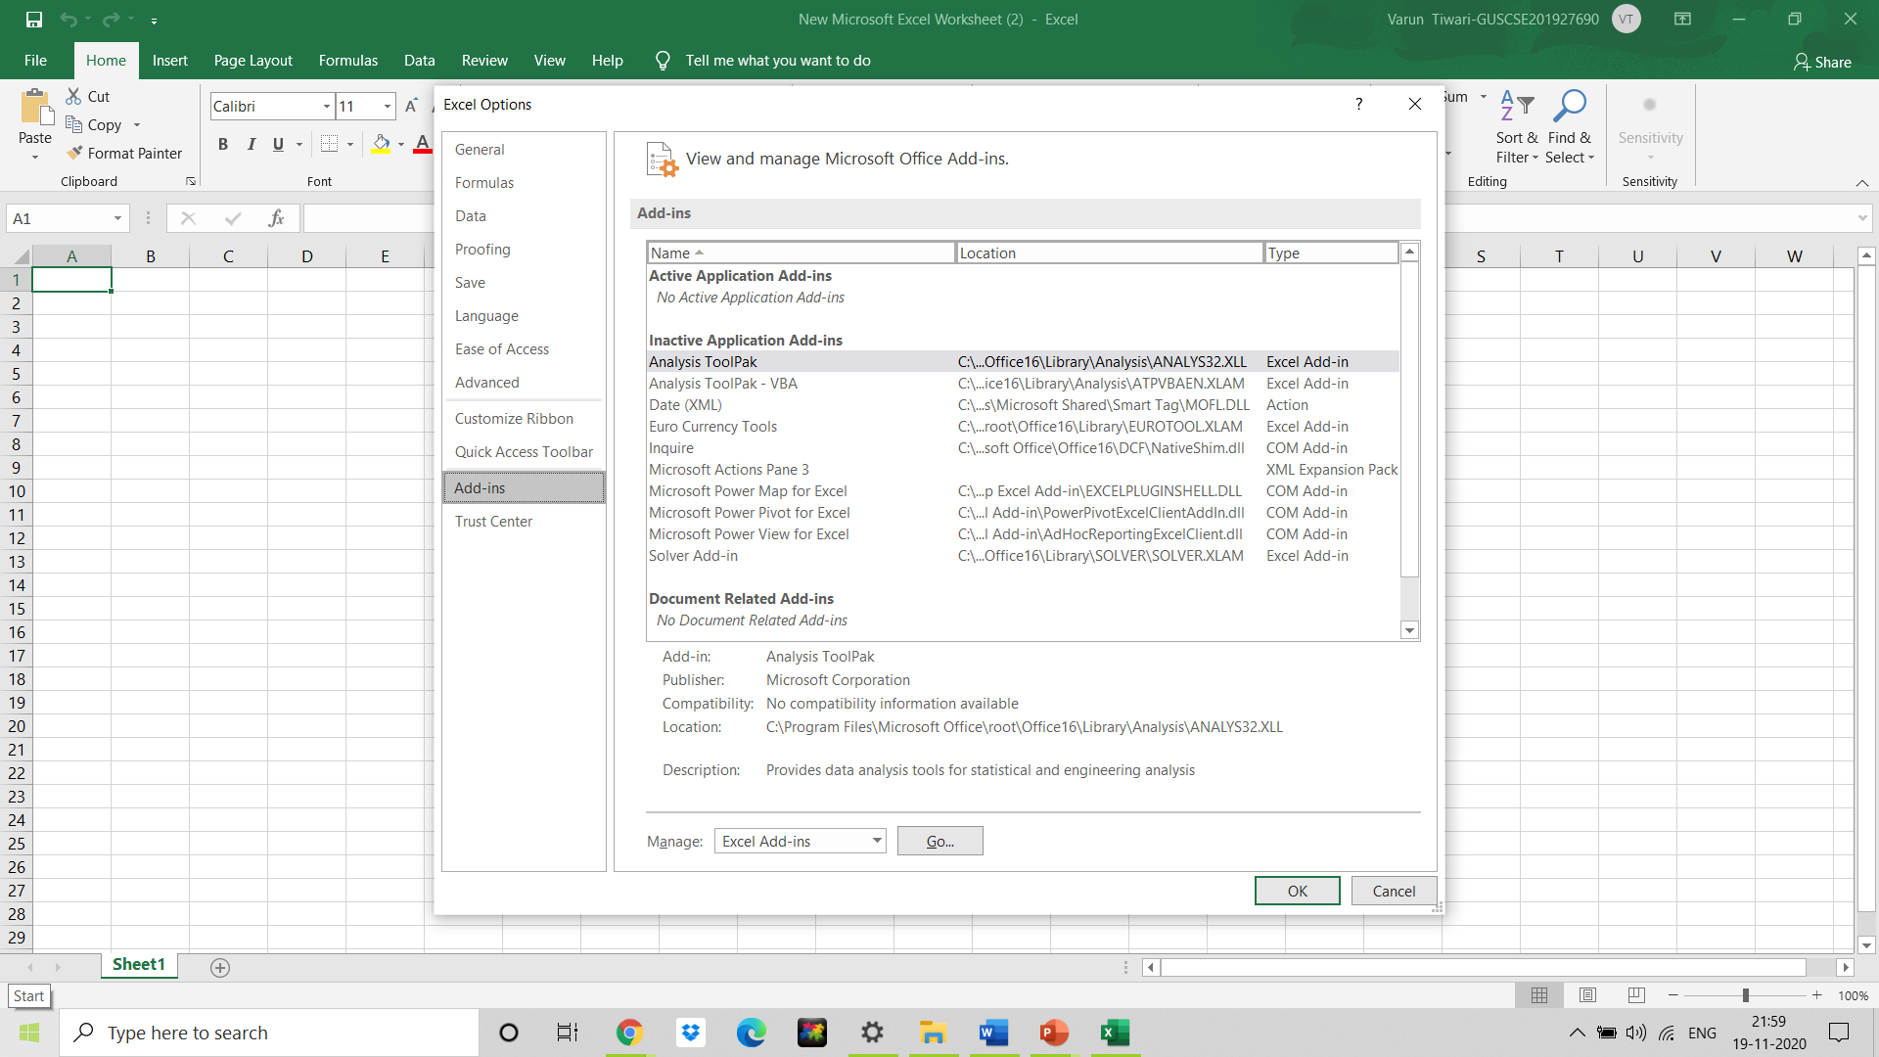
Installing Data Analysis Tool in Excel
In the Manage box, select Excel Add-ins and then click Go.

Slide 7
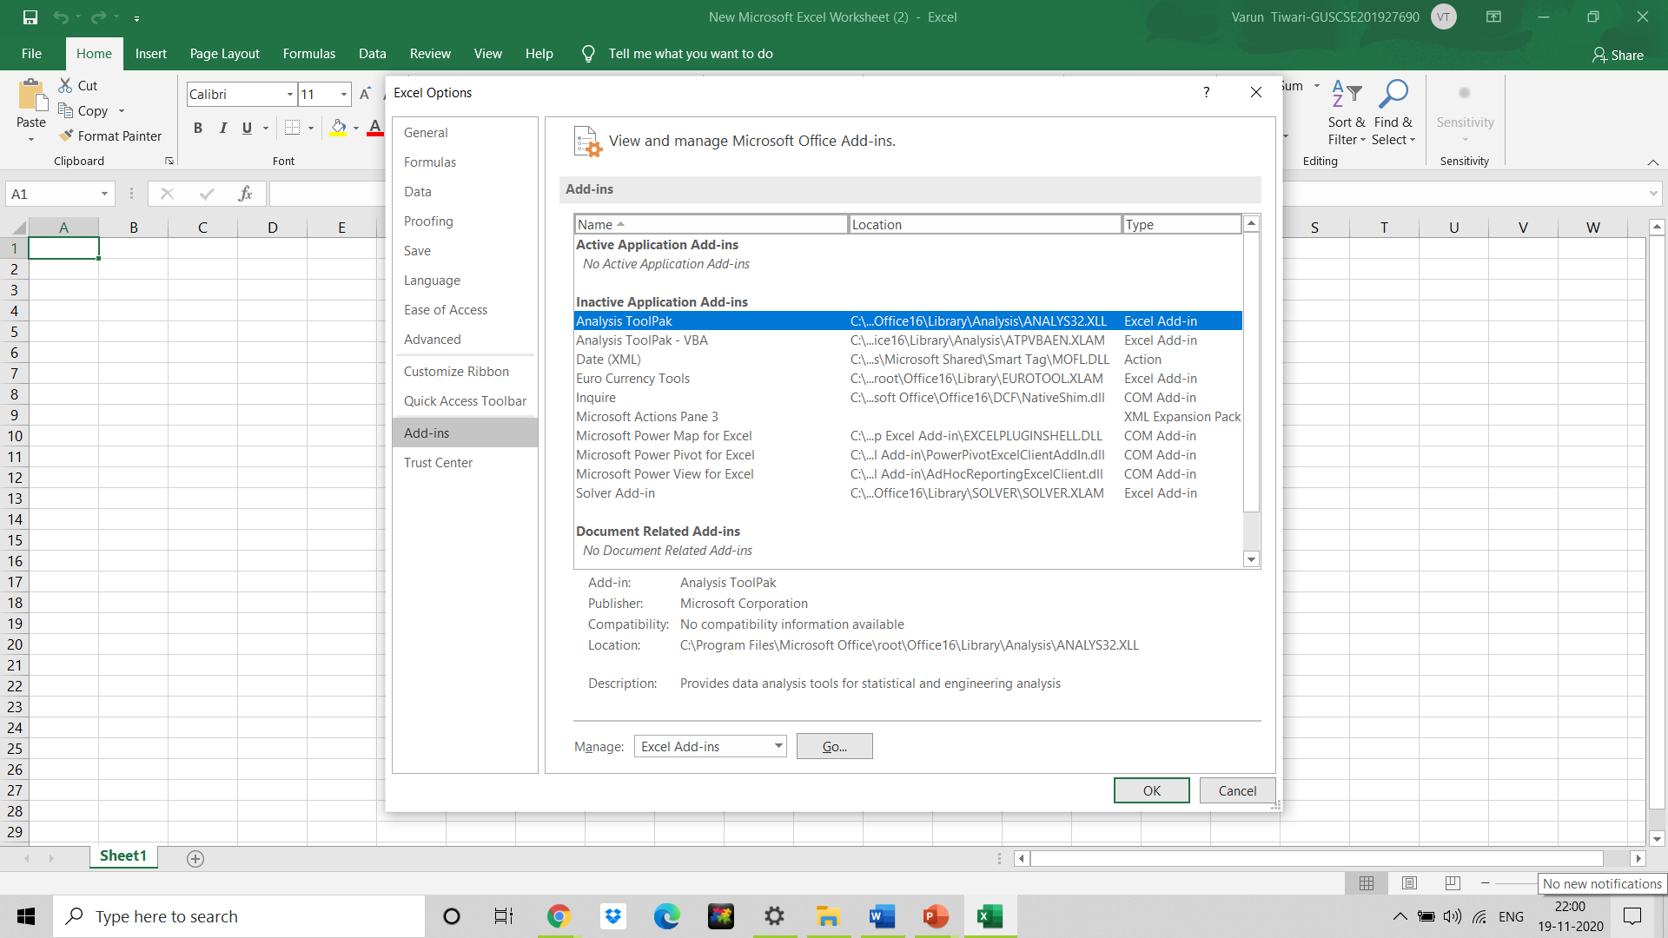
Installing Data Analysis Tool in Excel
In the Add-Ins available box, select the Analysis Tool Pack check box, and then click OK.

Slide 8
Basic Operation and Function in Excel
Using Excel Function wizard
COUNTIF, COUNTIFs SUMIF functions
Filtering data
Sorting data
Freezing data

Slide 9
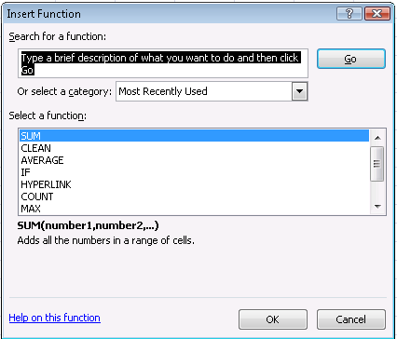
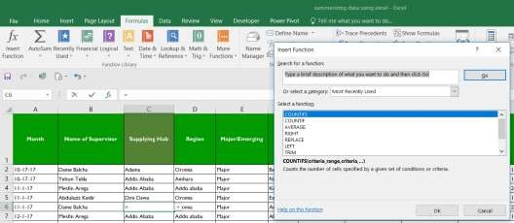
Function Wizard
Function wizard: enables to insert different function
Formula > insert function/ select from the list
insert function

Slide 10
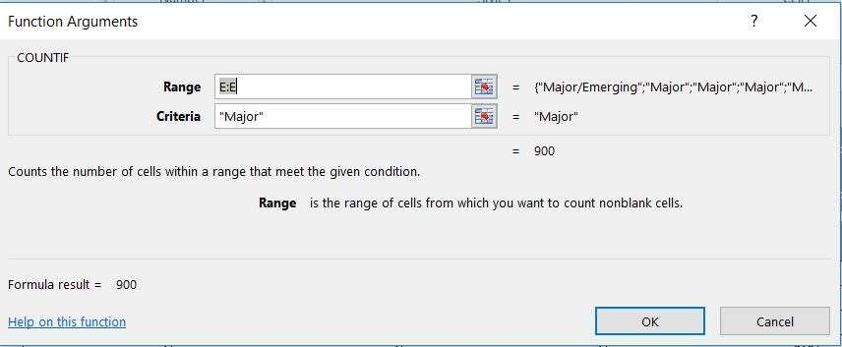
COUNTIF Function
counts the number of items in a range that meet a specific criteria.
Syntax : =COUNTIF(cells to count, criteria to count)
Lets count facilities supervised by region category

Slide 11
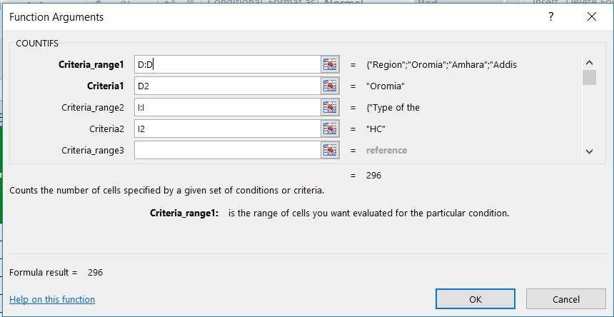
COUNTIFS Function
counts the number of items in a range that meet criterias.
=COUNTIFs(cells to count, criteria to count)

Slide 12
SUMIF Function
SUMIF function to sum the values in a range that meet the criteria specified
Syntax
SUMIF(range, criteria, [sum_range])

Slide 13
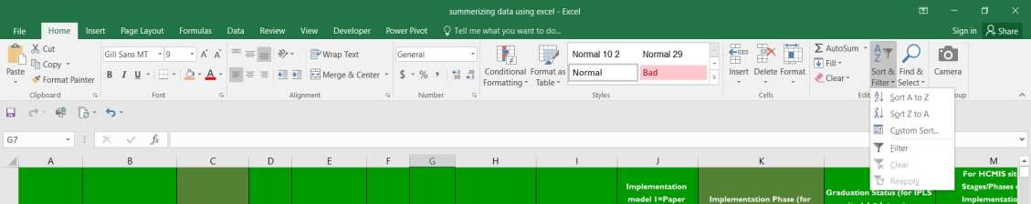
Filtering data
Filter your data if you want to display records that meet certain criteria.
Data>Filter data
Or
home > Sort & Filter > Filter

Slide 14
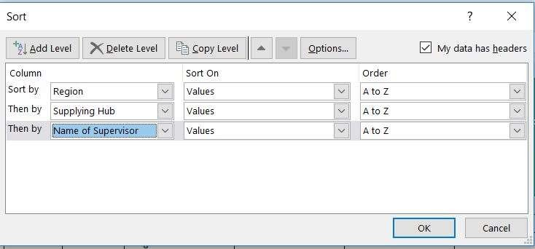
Sorting data
You can sort your Excel data on one column or multiple columns.
Data> sort data > select the column
Or
home > Sort & Filter > Sort
Lets Sort ss data
By region,
by suppling hub
Name of supervisor

Slide 15
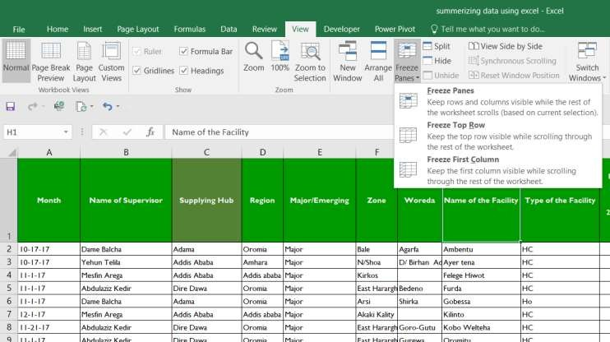
Freezing data
You can view part of your data
Freezes based on the
current selection
Most commonly used Freeze the title row / first row and you can scroll the rest data
Freeze the first column and you can scroll the rest data

Slide 16
Thank You

